Slide 1
Lets get started

Slide 2
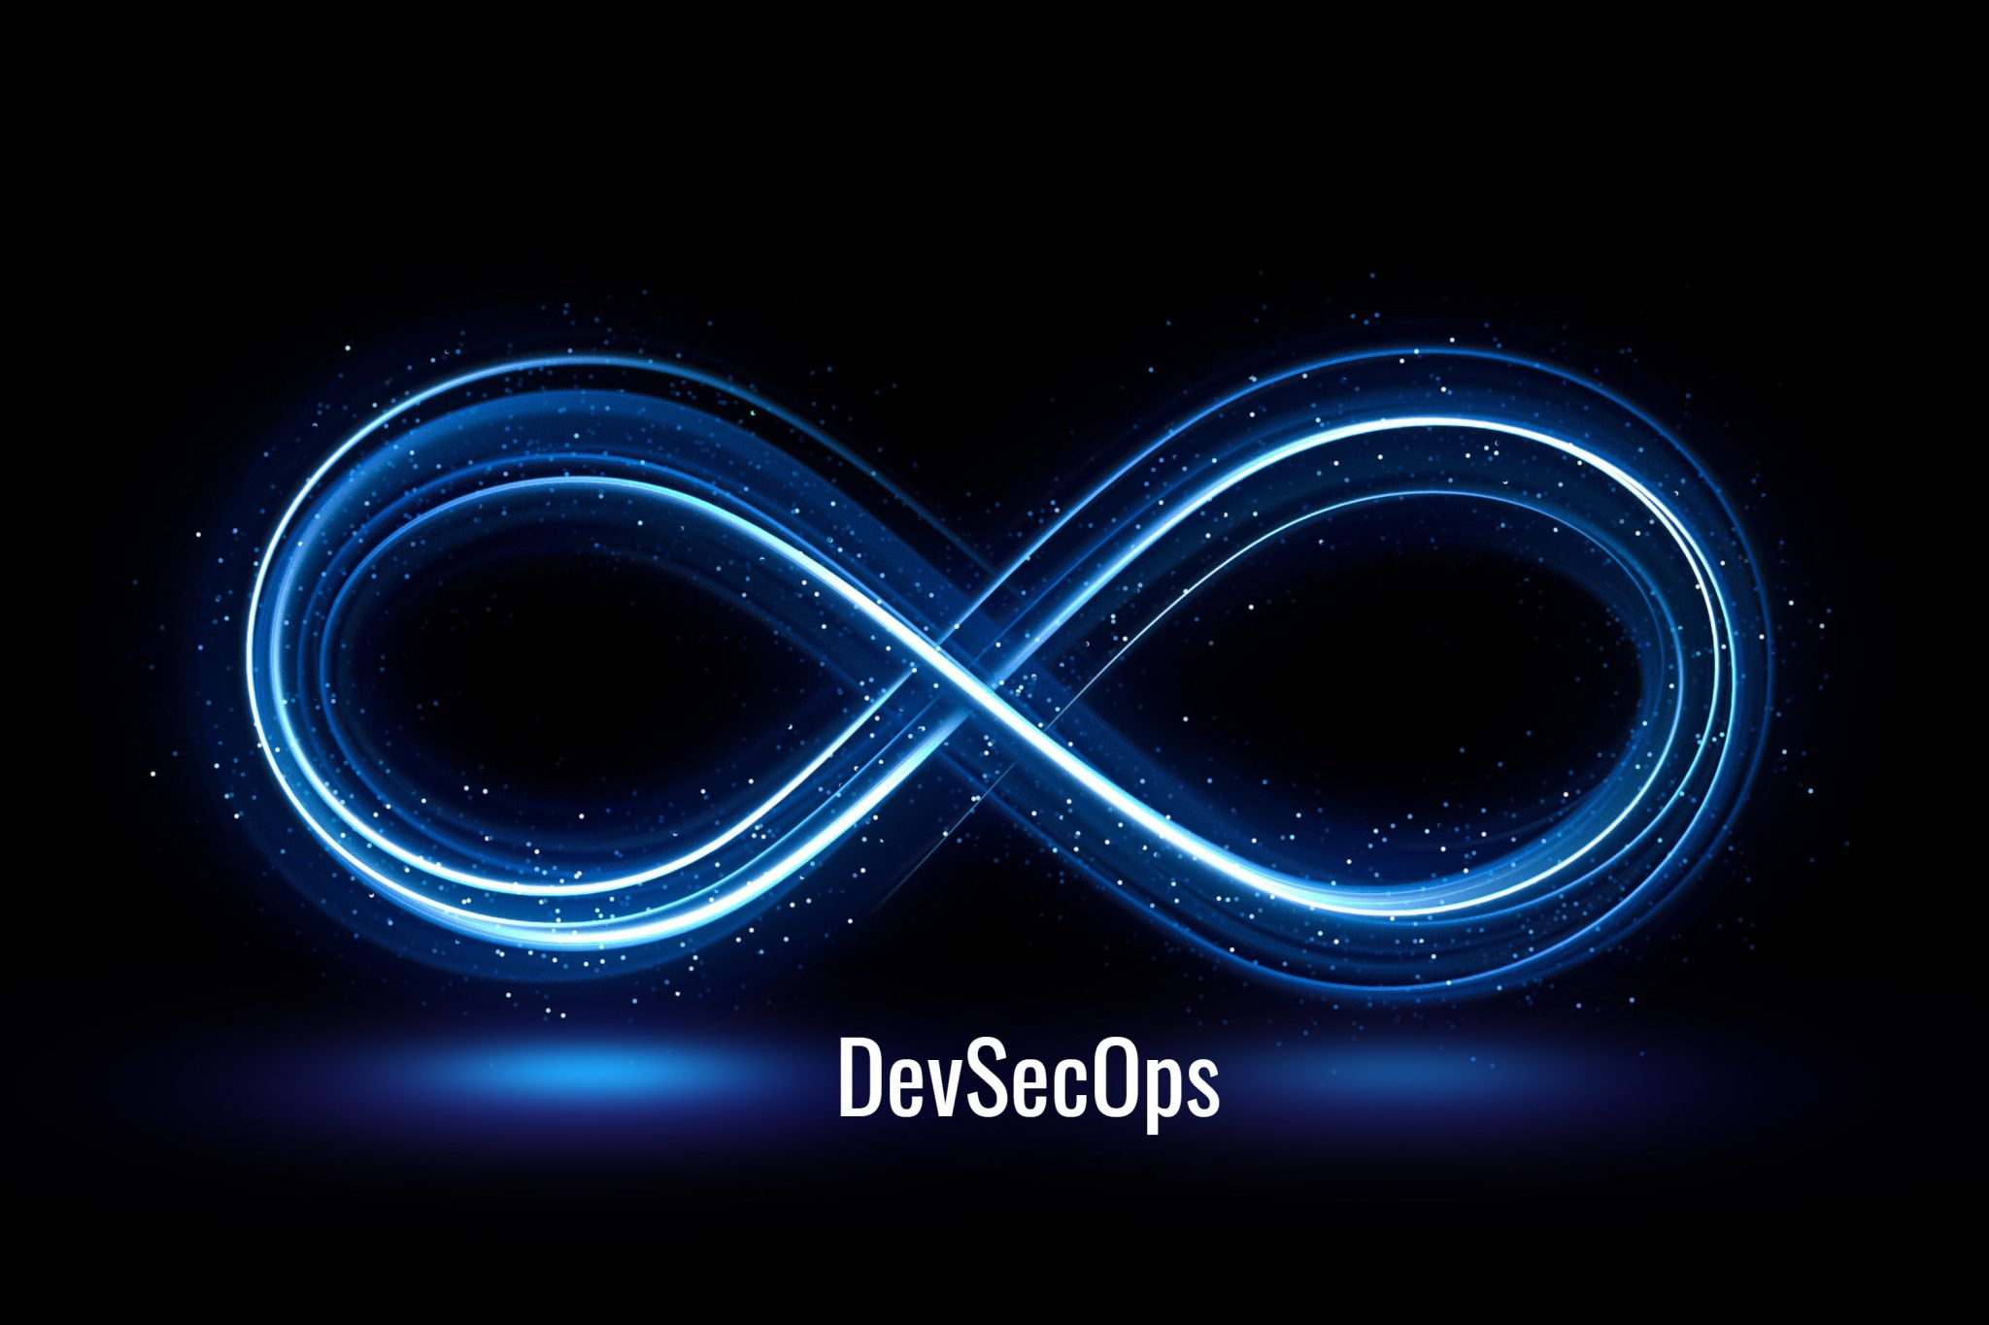
What are we going to see in this session?
Course Overview
Software development lifecycle
Quick view on DevOps
What is DevSecOps ?
Why do we need DevSecOps?
Benefits of DevSecOps
DevOps vs DevSecOps
Before adopting DevSecOps in SDLC
Enable security in planning phase
Enable security in coding phase
Enable security in build phase
Enable security in test phase
Enable security in deploy phase
Operate phase
The big picture
Areas of security can be imposed
Final wrap-up

Slide 3
Course overview
We are now in the mid’s of major software development transformation, where everything is achieved using piece of code.
During this webinar we are going to see how security practices can be incorporated in software development life cycle.

Slide 4
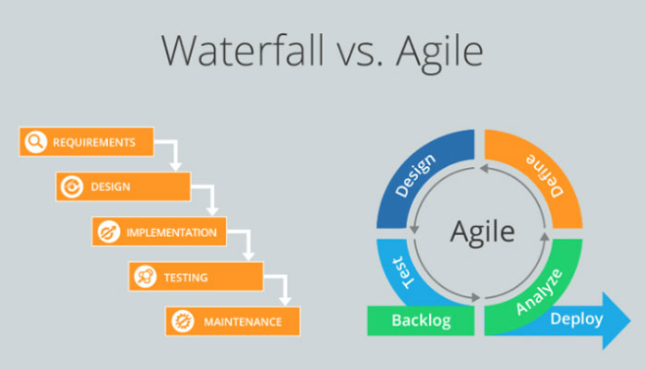
Software Development lifecycle
Software development did happens in two ways.

Slide 5
Quick view on DevOps
DevOps
Before we understand how to adopt DevSecOps in development life cycle we should understand how DevOps works.
DevOps is a practice which allows faster deployment which eventually results in faster product release.
This process is well known, and it's been in industry for a while, and it's been accepted as a successful practice.

Slide 6
What is DevSecOps ?
DevSecOps stands for Development, Security & Operations.
DevSecOps automatically bakes in security at every phase of the software development lifecycle, enabling development of secure software at the speed of Agile and DevOps.

Slide 7
Why do we need DevSecOps?
In the past, security was concerned only at the end of software development lifecycle wherein its been handled by separate security team and was tested by separate quality assurance (QA) team.
This was manageable when software updates were released once or twice a year, but the software development and delivery became rapid due to adaptation of Agile and DevOps practices, aiming to reduce software development cycles to weeks or even days. Hence following the same security process might become unacceptable bottleneck here.

Slide 8
Benefits of DevSecOps
Integrates application & infrastructure security seamlessly into Agile & DevOps processes & tools.
Addresses security issues as they emerge, when they're easier, faster & less expensive to fix (before they are put into production).
Additionally, DevSecOps makes security as shared responsibility of development, security, and IT operations teams, rather than the sole responsibility of a security silo.
Enables DevSecOps motto “software, safer, sooner” by automating the delivery of secure software without slowing the software development cycle.
Rapid, cost-effective software delivery
When software is developed in non-DevSecOps environment, security problems can lead to huge time delays, Fixing the code & security issues can be time-consuming, expensive.
The rapid, secure delivery of DevSecOps saves time and reduces costs by minimizing the need to repeat a process to address security issues after the fact.
This becomes more efficient and cost-effective since integrated security cuts out duplicative reviews and unnecessary rebuilds, resulting in more secure code.

Slide 9
Benefits (cont..)
Improved, proactive security
DevSecOps introduces cybersecurity processes from the beginning of the development cycle.
Throughout the development cycle, the code is reviewed, audited, scanned, and tested for security issues., issues are addressed as soon as they are identified.
Security problems are fixed before additional dependencies are introduced.
Security issues become less expensive to fix when protective technology is identified and implemented early in the cycle.
Accelerated security vulnerability patching
A key benefit of DevSecOps is how quickly it manages newly identified security vulnerabilities.
As DevSecOps integrates vulnerability scanning and patching into the release cycle.
This limits the window a threat actor has to take advantage of vulnerabilities in public-facing production systems.
Automation compatible with modern development
Security testing can be integrated into continuous integration/continuous delivery pipeline which helps to to ship their software with security functions enabled.
A repeatable and adaptive process
As organizations mature, their security strategies might mature.
DevSecOps lends itself to repeatable and adaptive processes.
This ensures security is applied consistently across the environment, as the environment changes and adapts to new requirements.

Slide 10
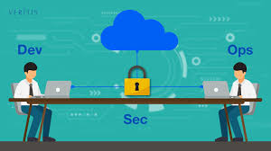
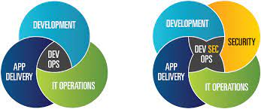
DevOps vs DevSecOps
Now you should some idea about DevSecOps.
DevSecOps is going to be an common entity which will be followed through out development life cycle.
There is no real reason to compare DevSecOps with DevOps because security is an additional entity which need to be incorporated at every stage of software development.

Slide 11
Before adopting DevSecOps in SDLC
We have couple of questionaries before adopting DevSecOps..
Adding a security along with DevSecOps is a nice idea, but is that so easy ?
Software development and deployment has many layers and tools involved within how are we going to incorporate security with it ?
What features and policies we may need to enable to deliver secure software ?
Where security can be applied?

Slide 12
Enable security in planning phase
There are many types of security can be involved at every phases of development life cycle.
Threat modelling
Threat modelling is a structured process to identify the types of threats that could cause harm to an application.
Some of tools used in this segment are
OWASP (Open source)
Core feature : Let’s you to create flow diagrams which could create Potential threat.
Threagile (open source)
Core feature : Aim is to achieve ‘Threat-Model-As-Code’
Input can be provided in the form of YAML files.

Slide 13
Enable security in code phase
Code standard
Improving coding standard from the beginning will always helps us to deliver quality product.
Hence enabling and maintaining coding standards are pretty important in development life cycle.
Code standards are collections of coding rules, guidelines and best practices.
Note : coding standards differ according the programming language which is chosen.
Some of common coding standards which could be followed,
Readability
Clarity
Insecure patterns
Hardcoded secrets
Insecure third-party libraries.
Insisting developers to use IDEs or code editors(Integrated development environments)
vscode
Sublime
Atom
Code Analysis
Can we ever imagine sitting back and manually reading each line of code to find flaws?
To ease our work, several types of static analysis tools are available in the market which helps to analyse the code during the development and detect defects early in the SDLC phase.
Some of well known tools are
SonarQube
Fortify static code analyser
CodeSonar etc..

Slide 14
Enable security in build phase
Vulnerability scans
Capturing vulnerability before it goes to test environment will give more confident on your software.
Many organizations use multiple vulnerability scanners, and each of it has its own pros and corns involved with it.
Some of the tools available in market to perform vulnerability scanning.
OpenVAS (open source)
Nmap (open source)
Nessus

Slide 15
Enable security in test phase
Penetration testing
Penetration testing is also knows as pen testing, is a simulated cyber attack against your IT infrastructure to check and exploit vulnerabilities.
Some of the tools available in market to perform pen testing.
Wireshark (open source)
Is most widely used network protocol analyser across the world.
Network traffic captured via Wireshark can show what protocols and systems are live, what accounts are most active, and allow attackers to intercept sensitive data.
Jhon the Ripper (open source)
John the Ripper is the original password cracking tool.
Its sole purpose is to find weak passwords on a system & expose them.

Slide 16
Enable security in deploy phase
Infrastructure
Ensure infrastructure competitive enough to handle attacks by enabling all required firewall standards.
Compliance
Enable compliance is indeed an important thing to be followed across development life cycle.
Imposing best practices and push everyone to follow the compliance policies are essential in modern world.
Validation
Ensure all required secure certifications are enabled.
Don't be afraid to ask how these certifications were granted and who conducted the relevant audits.
Conducting regular audits.

Slide 17
Operate phase
Once after things are stabilized and product is live, post responsibilities are pretty important.
Monitor
Detect
Respond
Recover

Slide 18
The big picture

Slide 19
Areas of security can be imposed
ENVIRONMENTS : Environment should be protected with proper authorization and authentication. DATA : Proper encryption of the data in any DBMS platform (NoSQL or SQL) and during transfer or data from its source to destination. CI/CD : Having security and threat verification implemented during application build and integration phase. Any CI/CD tool should be chosen with security in mind. DEPENDENCY : Modern day applications use sometimes 1000s of external libraries and APIs such as Maven JARs in Java and those need to verified for any threat or security issues or concerns. ACCESSIBILITY : There should be the least number of control access and individual user access. TESTING : Automated and Qualitative Security testing should be used in DevOps pipeline to make software's more secure and better. NETWORKING : There should be secure and isolated the networking between the services and components in a large enterprise software. API GATEWAYS : Ensure secure API gateways for load balancing and security checks in case of APIs and Microservices. POLICIES : Include security policies to secure your infrastructure. Security in configurations should also be implemented for secure infrastructures. ARTIFACTS & PACKAGES : Large applications create different artifacts or packages in different technologies and for different environments those need to be secured and verified for any bugs or vulnerability. SOURCE CODE : Code should be secure for any issues. SOFTWARE REQUIREMENTS : They should be accessed by required stakeholders only. SOFTWARE DOCUMENTS & ARCHITECTURE : Only required stakeholders should be able to modify and view those documents, roadmaps and diagrams. CLOUD ADMINISTRATION : Only required SREs should have control on deployments and infrastructure. PLATFORM & INFRASTRUCTURE : Security should be applied to all tools, systems and complete infrastructure in your DevOps pipeline.

Slide 20
Final wrap-up
The essence of DevOps is breaking down the silo between Dev (those who change/evolve systems) and Ops (those who maintain the stability of systems).
In the same way, the essence of DevSecOps is ensuring that the goals and voice of security and compliance are heard and incorporated along with development and operations.

Slide 21
End of this topic !
Any questions?

